Slide 1
MobiControl Automation (Acceptance +Upgrade Bdd)

Slide 2
Agenda
1
BDD Strategy / Approach
2
Tech Stack
3
BDD Componentization
4
BDD in CI Jenkins Pipeline
5
Upgrade Workflow
6
BDD.Upgrade Project Overview
7
Tags: Upgrade Project
8
Sample Upgrade Bdd

Slide 3


MobiControl Acceptance Testing using BDD
SOTI Confidential - Internal use only - Do not distribute

Slide 4

MC architecture
The Deployment Server/DSE: is the component that communicates with the mobile devices and executes the rules configured using MC web console. DS communicates with Android and Windows Mobile device. iOS and Windows Phone devices communicate with the DSE(Deployment Server Extension)​
The Management Server/Web Console: this component is responsible for providing a centralized environment from which all aspects of the system can be monitored and controlled. The MS communicates with the database and the deployment servers.​
The database: is used to store status and configurations information as well as the packages that are deployed to the devices. ​
The device agent is the MobiControl software which resided on the mobile devices. Device agents communicate with MC DS and are responsible for installing/uninstalling packages, as well as providing DS with real time information about the state of the device.
SOTI Confidential - Only for use under NDA - Do not distribute

Slide 5
Acceptance Testing
Acceptance Testing using Behavior-Driven Development (BDD) involves creating executable specifications that describe the expected behavior of a system from the perspective of its stakeholders.
Acceptance testing is a phase in software development where the software is tested for its compliance with business requirements and its readiness for deployment.
The primary goal of acceptance testing is to ensure that the software application meets the specified criteria and satisfies the needs of its end-users.
It serves as a final checkpoint before the software is deployed to production, helping to ensure a high level of quality and user satisfaction.

Slide 6
Acceptance Testing Continued…
A feature file is created for every functionality in MobiControl covering both positive and negative scenarios.
BDD for acceptance testing is executed on the latest code of master.
With introduction of any new functionality or modifications in the existing functionality, new BDD feature file is created or updated(TC addition or existing TC modification) accordingly to ensure BDD is up to date with the functionalities.
Feature File changes for Acceptance Testing are done at first and are reviewed once the story is delivered by Dev team, BDD implementation is to be done by the SDETs to ensure the maximum coverage through automation.

Slide 7
BDD Approach in MobiControl
APIs are tested as part of E2E tests which ensures that an app’s component function correctly at a level that includes the app's supporting infrastructure, such as the database, file system, and network. Scope of Acceptance BDD is Server-Side APIs along with integration with devices verified on respective platform simulators
The Feature Bdds are written in their respective platform class library projects which are part of Bdd solution in MobiControlBackend repo
A test runner is used to execute the tests and report the test results.

Slide 8
BDD Approach in MobiControl
BDD tests follow a sequence of events that include the usual Arrange, Act, and Assert test steps:
The Arrange test step is executed: The test app prepares a request.
The Act test step is executed: The client submits the request and receives the response.
The Assert test step is executed: The actual response is validated as a pass or fail based on an expected response.
The process continues until all the tests are executed.
The test results are reported.

Slide 9





Tech stack / Tools used

Slide 10
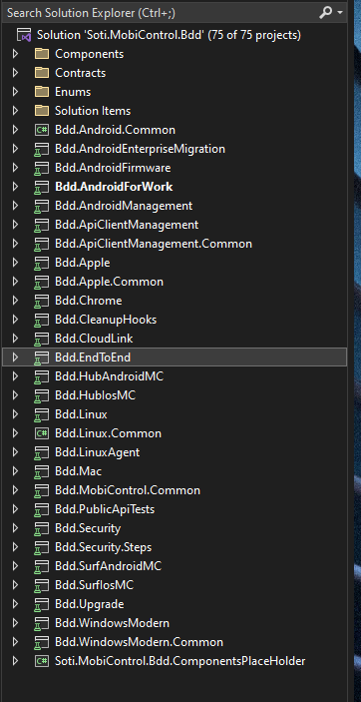
Bdd solution
Soti.Mobicontrol.Bdd is part of MobiControlBackend.Bdd
As referred from screenshot Acceptance Bdds are added in their respective platform class library projects
Acceptance Testing is done for all the platforms like-Android classic , Linux , Mac , AFW , Windows Modern Desktop, iOS, Windows CE, etc.
)

Slide 11
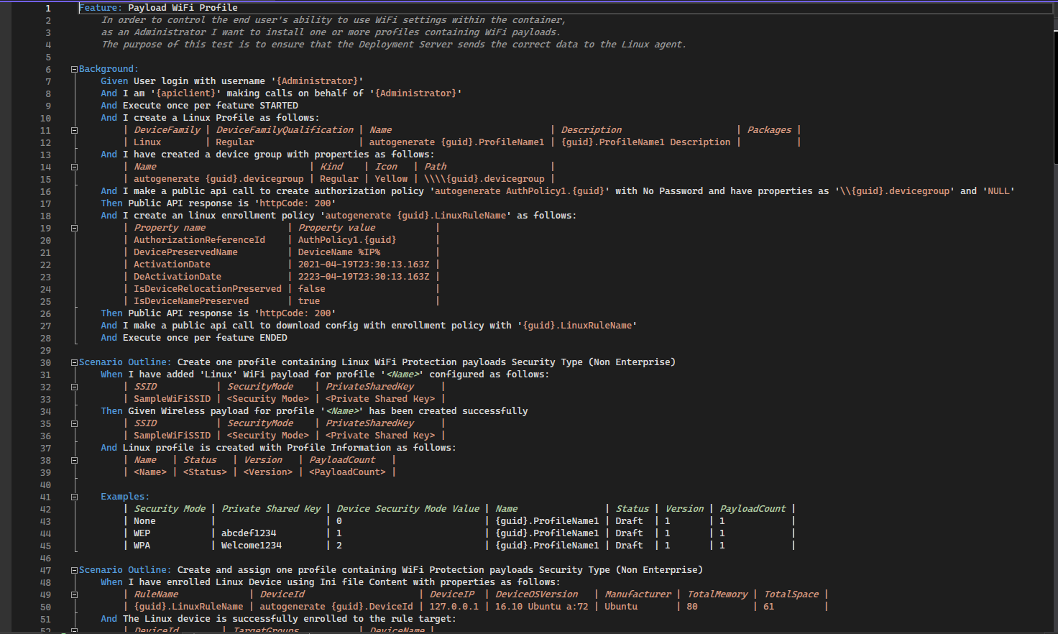
Sample Feature File (Acceptance Bdd)
)

Slide 12
Bdd Componentization Component based development

Slide 13
Problem Statement
Currently development of MobiControl backend is mostly being done in a single repo.
All teams (100+ developers) are contributing to the same code base. Code is highly coupled
Unintended changes to other feature can easily propagate to code base. Fast gated single-push check-in is hard to achieve.
Area impacted by code change is hardly identifiable.

Slide 14
PURPOSE OF BDD Componentization
Ability to test Feature Component functionality in isolation during Component CI pipeline run-in contrary, Web contracts and interfaces may expose that type of properties and interfaces
Compliment (co-locate) Component vertical slice of functionality with related Acceptance integration (BDD) tests.
BDD Core functionality and utilities (Soti.MobiControl.Bdd.Core NuGet) to be reusable across all Feature Components and monolith BDD
Reduce the execution of tests in Main pipeline

Slide 15
PURPOSE OF BDD Componentization…
BDD Common and Other Features steps available for Feature Component BDD Definitions creation.
Ability to have BDD Feature definitions (Nuget) at the same Repo locations (together with a Feature production code)
Break BDD Solution Monolith synchronously with Production MC Monolith componentization.

Slide 16
Conclusion: Componentization
New approach will allow to isolate development of one feature form every other ones. Every BDD failure will be easily attributed to a particular code change.
No impact on releasable code base until feature team is ready for integration with main solution.
For every feature under development a set of related BDD can be identified. Only relevant BDDs can be ran until integration phase is reached.
This will speed up gated check-in and will allow development in fast-pacing incremental manner with small commits and frequent integrations with feature code base.
As a good side effect this will also keep Master branch in releasable state most of the time.

Slide 17


BDD Architecture
Monolith BDD
…
…
…
…
…
T&C
Emails
App Policy
Enrollment
Certificate
BDD.CORE
Security, Events Log, Feature Toggle, & Keyword config
BDD Framework

Slide 18
Split Feature files and Step definition
Making steps definition reusable
Can be used by other component step definition
Component specific hook file
Better Testability

Slide 19
Limitations
Only feature Component Web API can be tested in BDD Componentization
Cannot be done in current scope
End to end scenarios like enrolling device
Execution of test case in Component CI (currently all test cases will be executed as part of main CI)

Slide 20
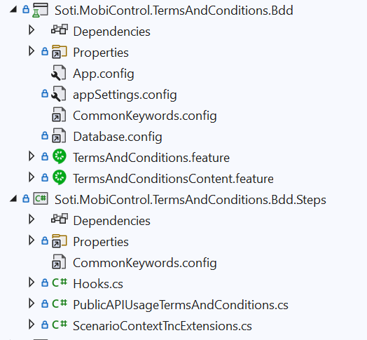
Project structure
Bdd feature file project
name: Soti.MobiControl.<Feature>.Bdd
namespace: Soti.MobiControl.<FeatureName>.Bdd
Bdd Steps definitions project
name: Soti.MobiControl.<FeatureName>.Bdd.Steps
namespace:Soti.MobiControl.<FeatureName>.Bdd.Steps
WikiLink:https://wiki.soti.net/index.php?title=Bdd_Component_Development_Guidelines#Moving_Bdd_Component_into_component_Repo_.28Github.29

Slide 21


Questions?
SOTI Confidential - Only for use under NDA - Do not distribute

Slide 22



Thank you
soti.net
© 2020, SOTI Inc. All Rights Reserved

